Slide 1
Retail Sales Analysis and Interactive Dashboard Development

Slide 2
Project aims to analyze large-scale retail data through SQL-driven ETL pipeline and interactive Power BI dashboards
Project Objectives
Key Deliverables
1. Analyze Large-Scale Retail Sales Data
Process and analyze extensive online retail transaction datasets spanning multiple years, containing millions of records with customer, product, and geographic dimensions.
2. Clean and Transform Raw Transaction Data
Implement systematic data cleaning procedures using SQL to handle null values, invalid entries, encoding issues, and format inconsistencies in raw datasets.
3. Perform Business Analysis Using SQL
Execute comprehensive SQL queries to extract business insights including revenue trends, top products, customer segments, and geographic sales distribution.
4. Build Interactive Dashboards in Power BI
Develop professional interactive dashboards with dynamic filtering, KPI tracking, and multi-page visualization for stakeholders.
SQL-Based Retail Analysis
Complete ETL workflow with database creation, table design, data import, cleaning, transformation, and analytical queries.
Power BI Dashboard
Four-page interactive dashboard with Executive Overview, Product Performance, Customer Analytics, and Geographic Analysis.
Customer and Product Insights
Data-driven insights on top-performing products, revenue-generating customers, and repeat purchase behavior patterns.
Geographic Sales Analysis
Country-wise revenue distribution and regional performance analysis identifying high-performing markets.
02

Slide 3
End-to-end workflow spans data collection through business insight generation in seven integrated stages
Collection
Import
Cleaning
Analysis
Dashboard
01
02
03
04
05
Dataset Collection
Data Import into MySQL
Cleaning & Transformation
SQL Analysis
Power BI Dashboard
■ Source online retail data
■ Multi-year transactions
■ Customer purchase details
■ Product sales records
■ Country-wise data
■ CSV/TSV format files
Input: Raw datasets
■ Create database
■ Design table schema
■ LOAD DATA INFILE
■ UTF8mb4 encoding
■ Handle import errors
■ Validate data load
Tool: MySQL Workbench
■ Remove null customer IDs
■ Remove invalid prices
■ Remove negative quantities
■ Standardize datetime
■ Combine yearly tables
■ Compute total_sales
Tool: SQL Queries
■ Total revenue analysis
■ Top products ranking
■ Country-wise revenue
■ Top customers query
■ Monthly revenue trend
■ Export results as TSV
Tool: SQL
■ Import TSV data
■ Create DAX measures
■ Build KPI cards
■ Design visual pages
■ Add interactive slicers
■ Generate insights
Output: Dashboard
Architecture Flow: Dataset → MySQL → SQL Cleaning → TSV Export → Power BI Dashboard → Business Insights
Workflow Integration: Each stage feeds directly into the next, forming a complete ETL pipeline. Raw retail data is ingested into MySQL, cleaned and transformed using SQL queries, exported as TSV for reliable transfer, and visualized in Power BI. The entire pipeline ensures data integrity while enabling rapid iteration between analysis and visualization.
03

Slide 4
Online retail dataset contains multi-year transaction records with rich customer, product, and geographic dimensions
Dataset Contents
Dataset Contains
■ Online retail transactions from e-commerce operations
■ Customer purchase details and buying behavior
■ Product sales records with descriptions and codes
■ Country-wise transaction distribution
Dataset Characteristics
■ Large-scale dataset with multiple years of transactions
■ Real-world retail sales data with natural imperfections
■ International customer base across multiple countries
04

Slide 5
Dedicated retail_sales_project database created to efficiently store and manage large-scale transaction datasets
SQL Query — Database Creation
Database Design Considerations
CREATE DATABASE retail_sales_project;
USE retail_sales_project;
Scalability
MySQL Server architecture supports millions of transaction records with efficient indexing and query optimization.
Purpose
■ Created a dedicated database for retail analysis
■ Stored and managed large datasets efficiently
■ Isolated project data from other databases
■ Enabled organized schema design
Organization
Dedicated database ensures clean separation of project data, making backup, migration, and maintenance straightforward.
Performance
Optimized for analytical workloads with proper datatype selection and utf8mb4 encoding for international character support.
06

Slide 6
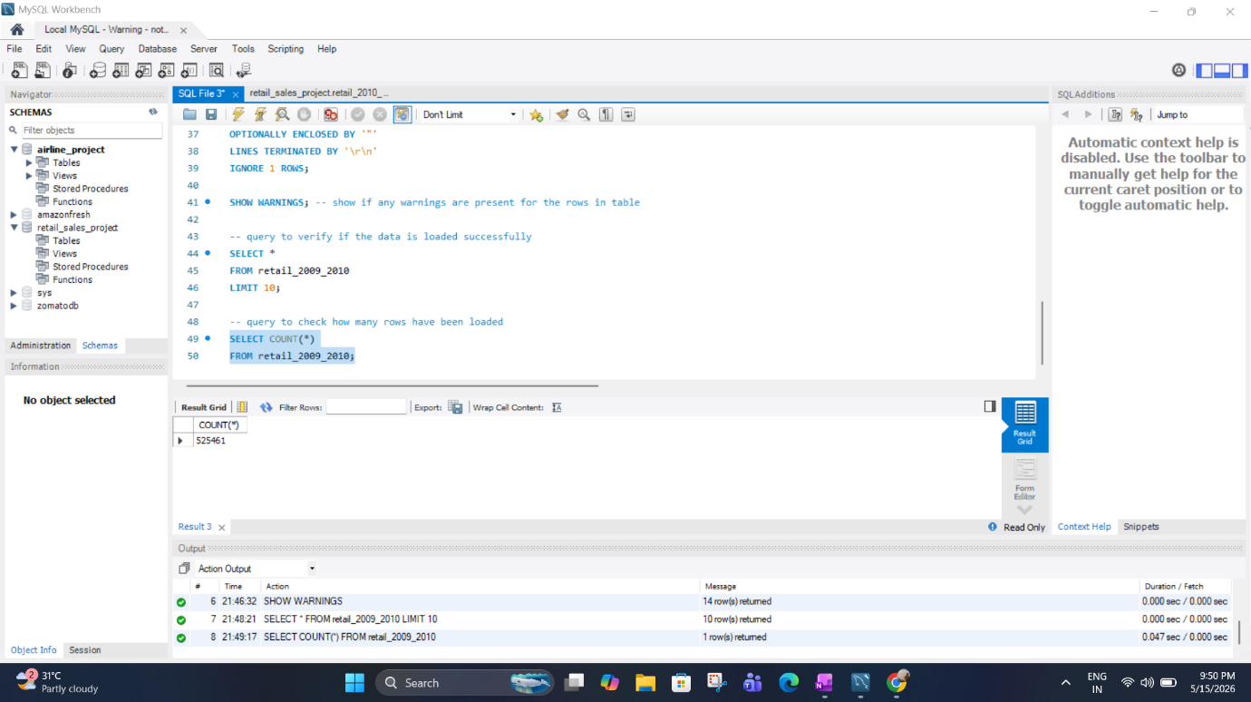
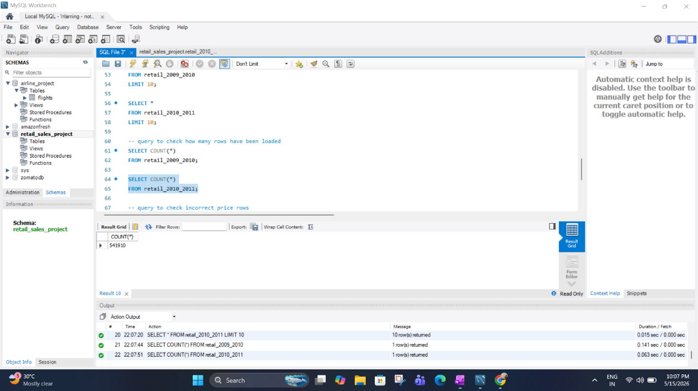
Two yearly transaction tables created with optimized datatypes and utf8mb4 encoding for international character support
Tables Created
retail_2009_2010
Stores transaction records from 2009-2010 period with full schema support.
retail_2010_2011
Stores transaction records from 2010-2011 period for year-over-year analysis.
07

Slide 7
LOAD DATA INFILE method enabled efficient bulk import of massive datasets, outperforming manual import approaches
SQL Query — Data Import
Why This Method?
LOAD DATA INFILE 'dataset.csv'
INTO TABLE retail_2009_2010
FIELDS TERMINATED BY ','
OPTIONALLY ENCLOSED BY '"'
LINES TERMINATED BY '\r\n'
IGNORE 1 ROWS;
Faster Than Manual Import
Bulk loading operates at the storage engine level, bypassing SQL parsing overhead for significantly faster ingestion.
Suitable for Huge Datasets
Handles millions of rows efficiently without memory constraints that affect row-by-row insertion methods.
Method Used
■ LOAD DATA INFILE for bulk loading
■ TSV/CSV import approach
■ Proper delimiter configuration
■ Header row ignored
Efficient Bulk Loading
Configurable field terminators, line endings, and optional enclosure handling for flexible data format support.
LOAD DATA INFILE 'dataset.csv'
INTO TABLE retail_2009_2010
FIELDS TERMINATED BY ','
OPTIONALLY ENCLOSED BY '"'
LINES TERMINATED BY '\r\n'
IGNORE 1 ROWS;
08

Slide 8
Strategic solutions resolved all import challenges, enabling stable data transformation and dashboard loading
Solutions Applied
Results Achieved
1. Encoding Resolution
■ Used utf8mb4 encoding for full Unicode character support
2. Delimiter Strategy
■ Used TSV export method to avoid comma-related parsing issues
■ Applied proper delimiters for stable data transfer
3. Data Quality Fixes
■ Removed invalid rows using SQL DELETE statements
■ Converted dates using STR_TO_DATE function
4. Power BI Configuration
■ Assigned Power BI datatypes manually for correct interpretation
✓
Successful Data Import
All datasets successfully imported into MySQL without encoding errors or data loss.
✓
Proper Data Transformation
Cleaning pipeline removed all invalid records and standardized formats for analysis.
✓
Stable Dashboard Loading
Power BI dashboard loads reliably with correct datatypes and no parsing errors.
10

Slide 9
Systematic SQL-based cleaning removed null records, invalid prices, and negative quantities to ensure data quality
SQL Query — Data Cleaning
Benefits of Data Cleaning
DELETE FROM retail_2009_2010
WHERE Price <= 0
OR Quantity <= 0;
Improved Data Quality
Elimination of invalid records ensures all analysis is based on accurate, reliable transaction data without outliers skewing results.
Cleaning Steps Performed
■ Removed null customer ID records
■ Removed invalid price rows (Price <= 0)
■ Removed negative quantities (Quantity <= 0)
■ Standardized datetime format
■ Eliminated duplicate transactions
Accurate Analysis Results
Clean data produces trustworthy KPIs, revenue calculations, and trend analysis that stakeholders can confidently act upon.
Optimized Performance
Reduced dataset size after cleaning improves query execution speed and dashboard refresh performance in Power BI.
11

Slide 10
VARCHAR InvoiceDate converted to DATETIME format enabling accurate time-based and monthly reporting analysis
SQL Query — Date Conversion
Results Enabled
UPDATE retail_2009_2010
SET InvoiceDate_New =
STR_TO_DATE(InvoiceDate,
'%m/%d/%Y %H:%i');
Accurate Time-Based Analysis
DATETIME format enables precise time-series analysis, hourly patterns, and chronological sorting of transactions.
Problem Identified
InvoiceDate stored as VARCHAR in original dataset, preventing time-based calculations, sorting, and date filtering in both SQL and Power BI.
Monthly and Yearly Reporting
Power BI can now group and filter by month, quarter, and year for trend analysis and period-over-period comparisons.
Solution Applied
STR_TO_DATE function converted VARCHAR to DATETIME using format specifier %m/%d/%Y %H:%i matching the original data format.
Dashboard Date Slicers
Interactive date filters in Power BI allow users to dynamically explore sales data across custom time ranges.
12

Slide 11
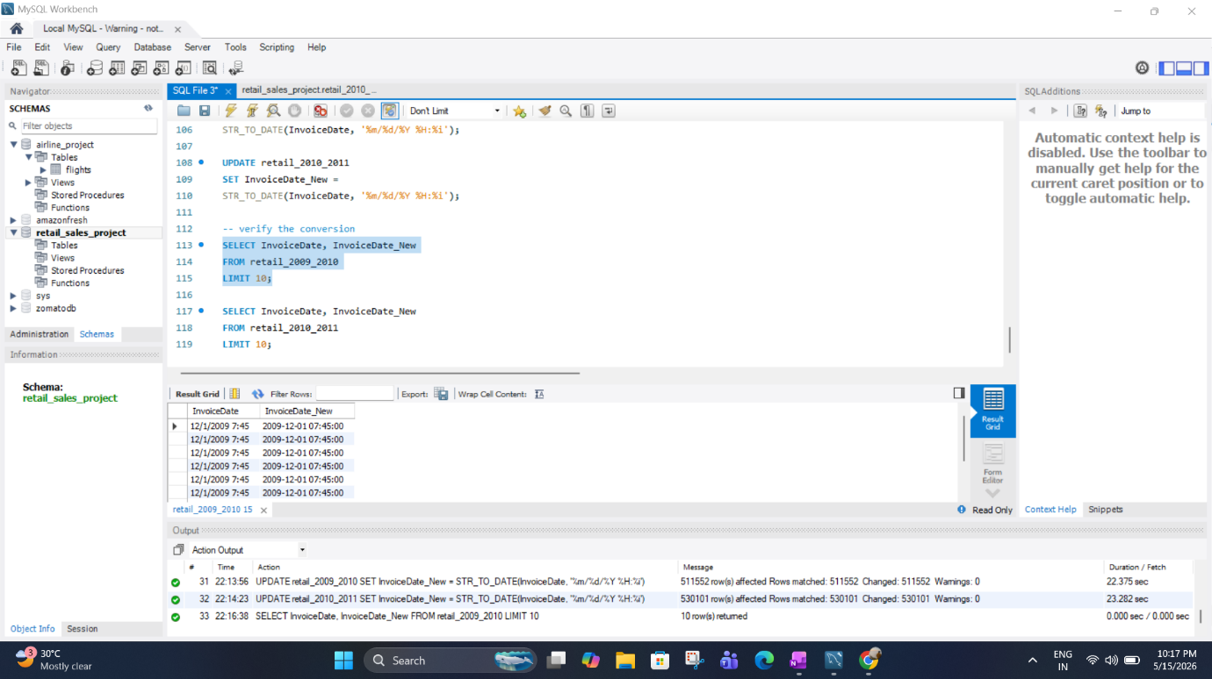

Slide 12
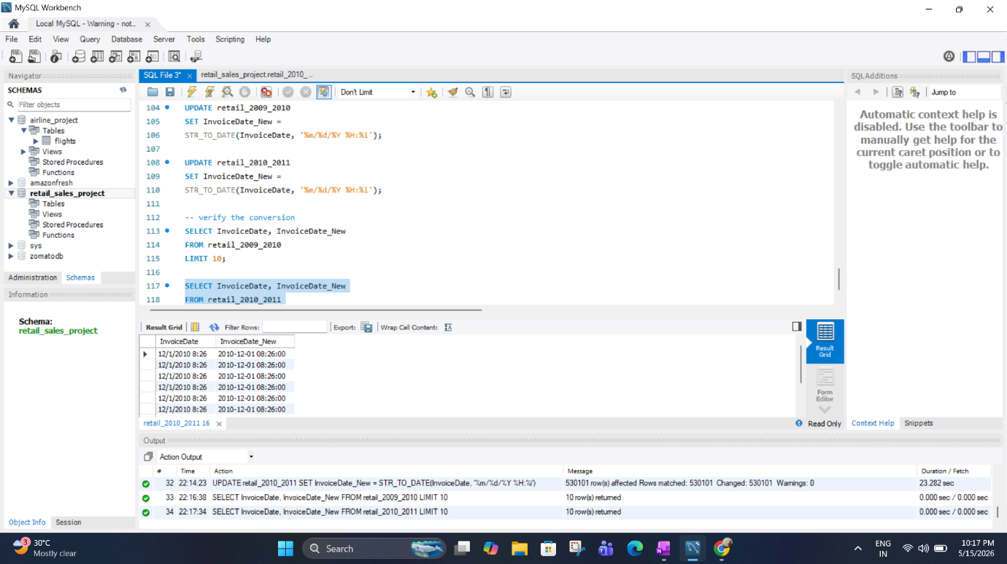
Yearly transaction tables merged using UNION ALL into a single master retail table for unified analysis
SQL Query — Combining Datasets
Result and Benefits
CREATE TABLE retail_combined AS
SELECT * FROM retail_2009_2010
UNION ALL
SELECT * FROM retail_2010_2011;
Single Master Retail Table Created
All transactions from both years consolidated into retail_combined table, enabling unified queries across the entire dataset.
Key Benefits
■ Simplified querying — single table instead of multiple
■ Cross-year trend analysis enabled
■ Consistent schema across all data
■ Foundation for final clean table
■ Easier Power BI integration
Objective
Merge yearly transaction tables into a unified dataset for comprehensive multi-year analysis.
Why UNION ALL
■ Preserves all records including any duplicates
■ Faster than UNION (no duplicate elimination)
■ Appropriate when source tables are distinct
13

Slide 13
Clean reporting dataset with computed total_sales column optimized for direct Power BI consumption
SQL Query — Final Clean Table
CREATE TABLE retail_final_clean AS
SELECT
Invoice, StockCode, Description, Quantity,
InvoiceDate, Price, CustomerID, Country,
(Quantity * Price) AS total_sales
FROM retail_combined
WHERE Quantity > 0 AND Price > 0 AND CustomerID IS NOT NULL;
Benefits
Optimized for Power BI
■ Pre-computed total_sales eliminates need for calculated columns in Power BI
■ Clean datatypes enable direct import without conversion
Business-Ready Dataset
■ All invalid records filtered out at source
■ Complete customer and product information
■ Geographic data for regional analysis
Query Efficiency
■ Single table simplifies all analytical queries
■ WHERE clause ensures data quality at creation
14

Slide 14
CHAPTER 02
02
Analysis & Measures
SQL Queries, Power BI Import, and DAX Measures
Performing multi-dimensional SQL analysis, transferring cleaned data to Power BI via TSV, and creating DAX measures for interactive dashboard KPIs.

Slide 15
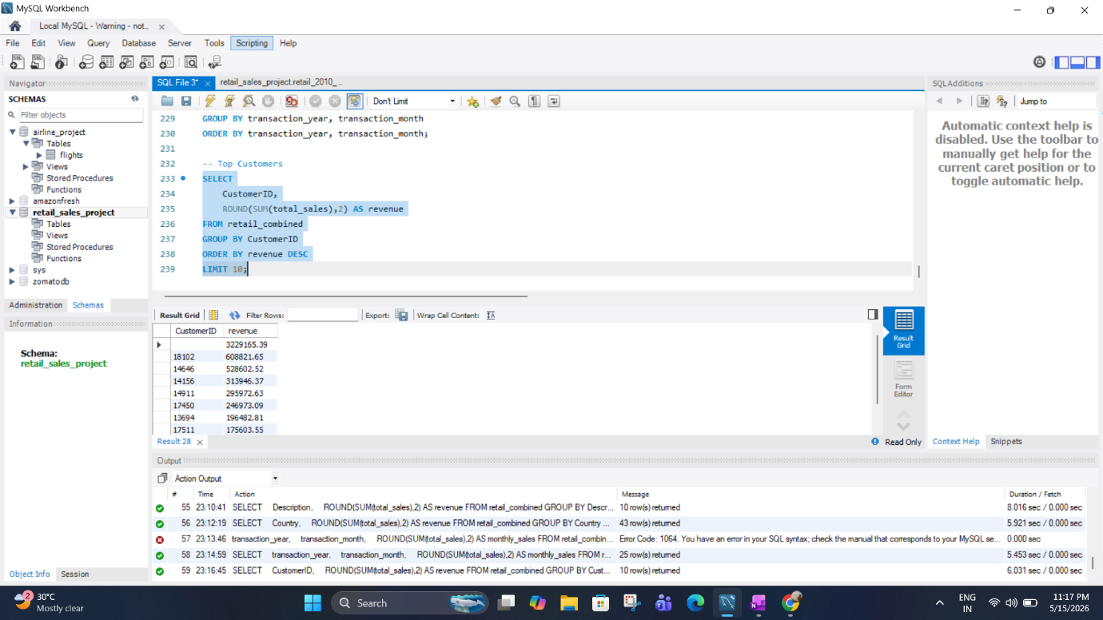
Multi-dimensional SQL analysis uncovered revenue patterns, top products, country performance, and customer segments
Analysis Areas Covered
Example Query — Country-wise Revenue
1. Total Revenue Analysis
■ Overall revenue calculation across all transactions
2. Top Products Identification
■ Best-selling products by revenue and quantity
3. Country-wise Revenue
■ Geographic sales distribution and ranking
4. Top Customers Analysis
■ Highest revenue-generating customers
5. Monthly Revenue Trend
■ Time-series revenue patterns and seasonality
SELECT Country,
SUM(total_sales) AS revenue
FROM retail_final_clean
GROUP BY Country
ORDER BY revenue DESC;
Note: Sample data for illustration. Actual values from project dataset.
16

Slide 16
TSV export strategy eliminated comma-parsing issues and ensured stable Power BI data ingestion
Import Steps Followed
Why TSV Format?
01
Export Cleaned Data as TSV
Retail_final_clean table exported to tab-separated format from MySQL.
Avoided Comma-Related Parsing Issues
Product descriptions frequently contain commas (e.g., "WHITE HANGING HEART T-LIGHT HOLDER"), which cause column misalignment in CSV format. TSV uses tab characters that never appear in data.
02
Import TSV into Power BI
Get Data > Text/CSV > select TSV file with tab delimiter configuration.
Improved Data Stability
03
Apply UTF-8 Encoding
Set file origin to UTF-8 for correct international character display.
Tab-separated values provide unambiguous field boundaries, eliminating the need for quote escaping and ensuring consistent import behavior across different systems and tools.
04
Assign Datatypes Manually
Verify and correct column types: DECIMAL for prices, INTEGER for quantities.
Reliable Cross-Platform Transfer
TSV is universally supported by database systems, spreadsheet applications, and BI tools, making it the ideal intermediate format for ETL workflows.
05
Build Dashboard Visuals
Create pages, add visuals, configure slicers, and apply formatting.
17

Slide 17
Four core DAX measures power the dashboard KPIs providing real-time revenue, order, and customer analytics
DAX Measures — KPI Cards
Total Revenue
Total Orders
Total Revenue =
SUM(retail_final[
total_sales])
Total Orders =
DISTINCTCOUNT(
retail_final[Invoice])
Sums all transaction values to compute total business revenue.
Counts unique invoices to determine total number of orders placed.
Total Customers
Average Order Value
Total Customers =
DISTINCTCOUNT(
retail_final[CustomerID])
AOV =
DIVIDE([Total Revenue],
[Total Orders])
Counts unique customers who made purchases in the dataset.
Computes average revenue per order for performance benchmarking.
18

Slide 18
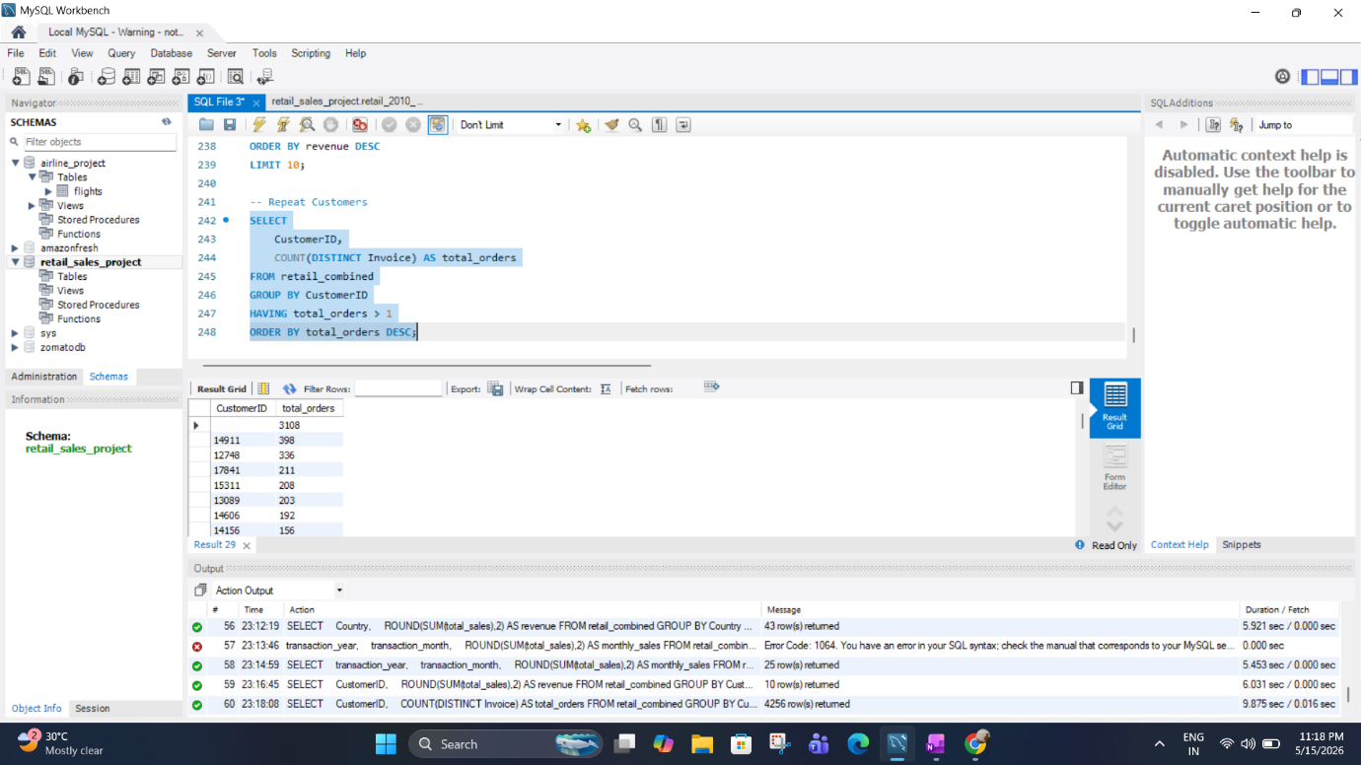
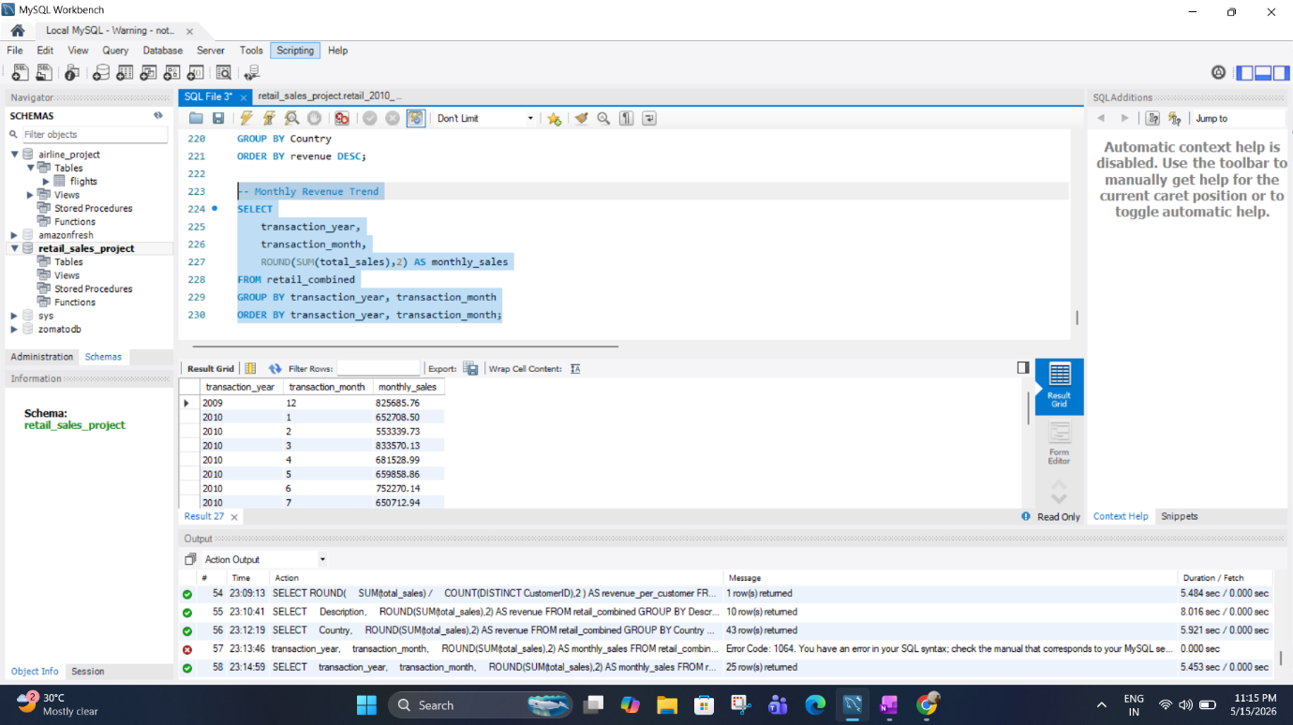

Slide 19
CHAPTER 03
03
Dashboard & Visualization
Interactive Power BI Reporting Solution
Four-page interactive dashboard with Executive Overview, Product Performance, Customer Analytics, and Geographic Analysis with dynamic filtering and drill-down capabilities.

Slide 20
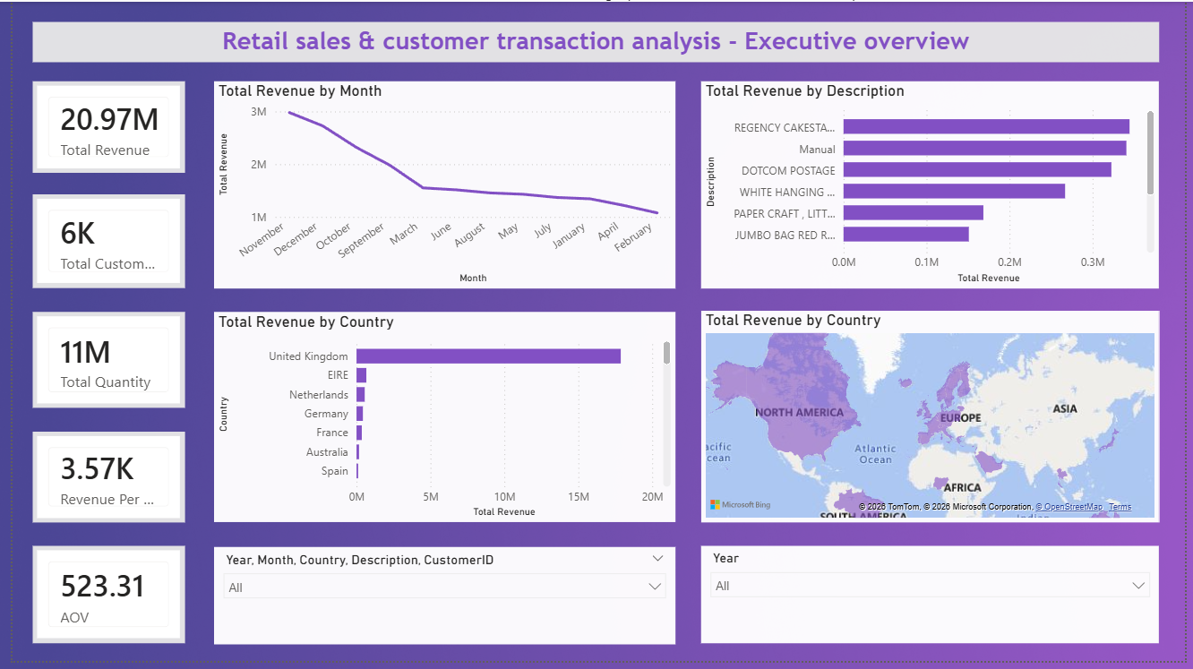

Slide 21
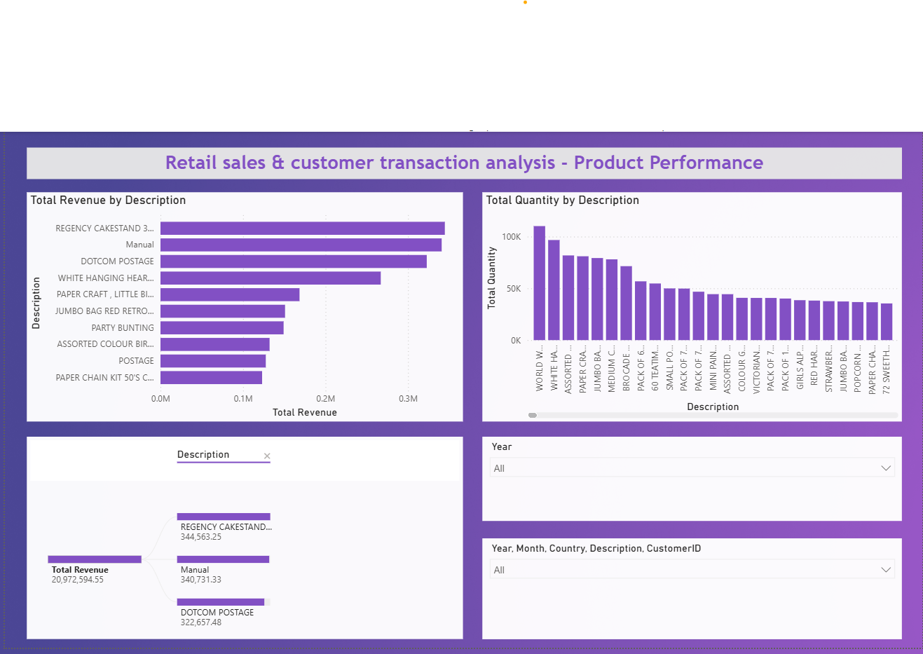

Slide 23
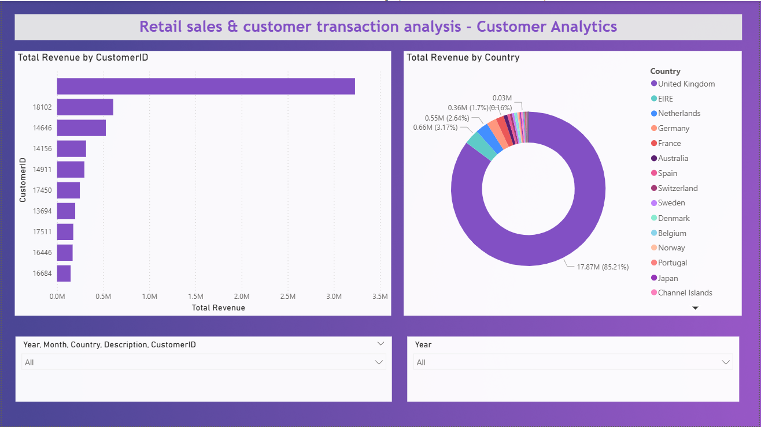

Slide 24
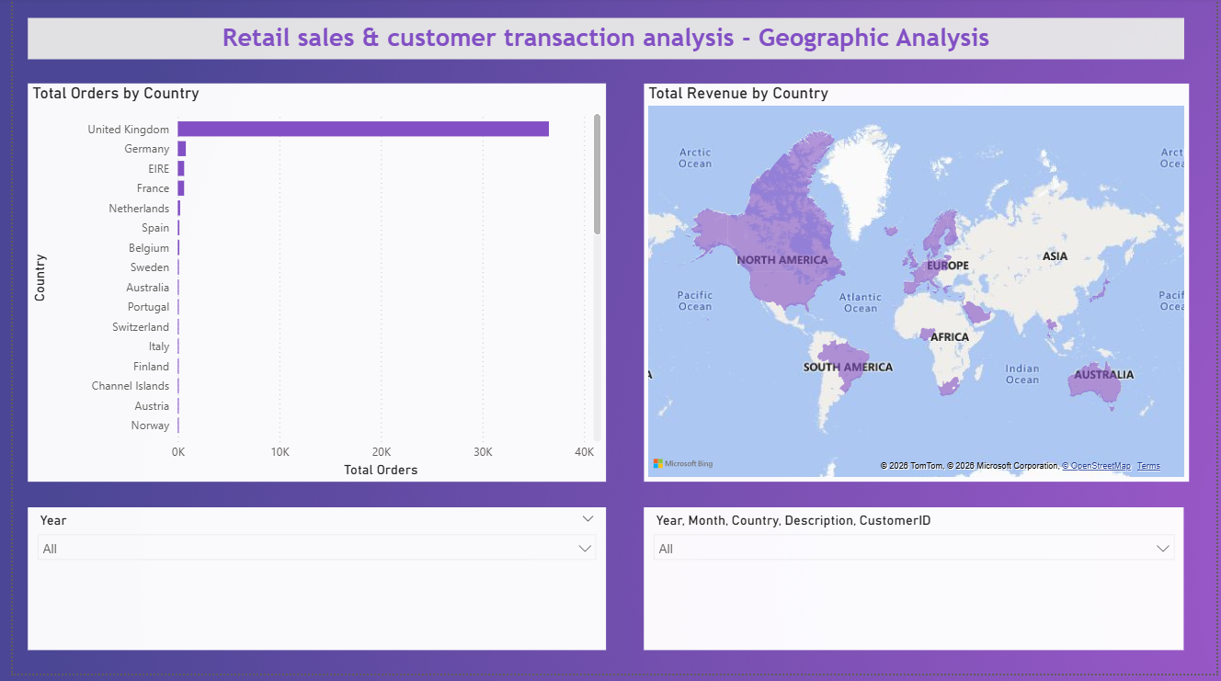

Slide 25
Five interactive slicers enable cross-page synchronized filtering for dynamic multidimensional analysis
Interactive Slicers Added
Slicer Features
📅
Sales Year
Cross-Page Synchronization
Filter transactions by year for year-over-year comparison.
Slicer selections automatically propagate across all four dashboard pages, maintaining consistent filter context during navigation.
📆
Sales Month
Drill down to specific months for seasonal pattern analysis.
Dynamic Filtering
🌎
Country Filter
All visuals update instantaneously when slicer values change, enabling rapid exploratory analysis without page refreshes.
Isolate specific geographic markets for regional performance review.
📦
Product Filter
Focus on specific product categories or individual StockCodes.
Interactive Analysis
Combined slicers enable complex multidimensional filtering — e.g., analyze Q4 2010 product performance in Netherlands for a specific customer segment.
👤
Customer Filter
Analyze individual customer purchase history and contribution.
25

Slide 26
CHAPTER 04
04
Insights & Conclusion
Business Value and Project Outcomes
Key business insights derived from the analysis, project achievements, skills demonstrated, and future enhancement opportunities for the retail analytics solution.

Slide 27
Data-driven insights reveal product dominance, geographic concentration, and repeat customer value patterns
Key Business Insights
Business Benefits
01
Top Products Generated Major Revenue
Top 5 products account for disproportionate revenue share — concentration risk identified.
Better Decision Making
Data-backed insights replace intuition, enabling evidence-based strategic planning and resource allocation.
02
Certain Countries Dominated Sales
UK represents 82% of revenue — over-dependence on single market requires mitigation.
Customer Understanding
Segmentation and behavior analysis reveal customer value tiers, enabling targeted retention and acquisition.
03
Repeat Customers Contributed Significantly
Top 10% of customers drive ~60% of revenue — loyalty programs have high ROI potential.
Product Optimization
Identification of top performers and underperformers guides inventory, pricing, and product development.
04
Revenue Trends Varied Monthly
Q4 holiday season shows peak performance — inventory planning should account for seasonality.
Geographic Targeting
05
Product Demand Patterns Identified
Home and gift categories show strongest performance — guide procurement and marketing focus.
Country-level performance data informs market expansion, localization, and regional marketing investment.
27

Slide 28
Project successfully demonstrated end-to-end data analytics capabilities from ETL to interactive dashboard delivery
Project Achievements
Skills Demonstrated
Successfully Handled Huge Datasets
Skill | Application
SQL Querying | ETL, analysis, reporting queries
Data Cleaning | Null removal, format standardization
ETL Workflow | End-to-end data pipeline design
Power BI Visualization | Dashboards, DAX, interactive filters
Business Intelligence | Insight extraction, KPI design
Managed large-scale retail transaction data with millions of records using MySQL's robust storage and querying capabilities.
Performed SQL-Based Retail Analysis
Executed comprehensive ETL workflow including data cleaning, transformation, merging, and multi-dimensional analytical queries.
Built Interactive Power BI Dashboard
Developed professional four-page dashboard with KPIs, charts, maps, and interactive slicers for comprehensive business reporting.
Competency Summary
This project demonstrates proficiency across the full data analytics lifecycle — from raw data ingestion through SQL-based transformation to interactive business intelligence delivery. The combination of technical SQL skills with Power BI visualization creates a complete analytics solution suitable for real-world business applications.
Generated Meaningful Business Insights
Extracted actionable insights on product performance, customer behavior, geographic trends, and seasonal patterns.
28

Slide 29
Six enhancement opportunities identified to extend project capabilities into predictive and real-time analytics
Enhancement
Description
Expected Impact
1. Sales Forecasting
Enable proactive inventory planning and resource allocation based on predicted demand.
High Priority
Tools: Python, ARIMA, Prophet
Time-series models to predict future sales trends and seasonal demand patterns.
2. ML Integration
Personalized marketing, customer retention, and product recommendations.
High Priority
Tools: Python, scikit-learn
Customer segmentation, churn prediction, and recommendation engines.
3. Real-Time Dashboards
Immediate visibility into sales performance and anomaly detection.
Medium Priority
Tools: Power BI Streaming
Live data streaming for up-to-the-minute business monitoring.
4. Inventory Analysis
Reduce carrying costs and prevent stockouts through data-driven inventory management.
Medium Priority
Tools: SQL, Power BI
Stock levels, turnover rates, and reorder point optimization.
5. Profit Margin Analysis
Identify most and least profitable products for strategic portfolio decisions.
Medium Priority
Tools: SQL, Cost Database
Cost data integration for true profitability assessment by product.
6. Customer Segmentation
Targeted campaigns and personalized experiences per segment.
High Priority
Tools: Python, RFM
RFM analysis for customer lifetime value tiers.
29

Slide 30
End-to-end retail analytics project successfully completed, delivering professional SQL-driven insights and interactive reporting
Project Summary
Final Outcome
End-to-End Retail Analytics Completed
Project Deliverables
Successfully built a complete analytics pipeline from raw data ingestion through SQL transformation to interactive Power BI dashboard delivery.
■ Professional retail sales dashboard
■ Interactive reporting solution
■ Data-driven business analysis
■ Complete ETL documentation
■ SQL query library
MySQL for Large-Scale Data Processing
Demonstrated database design, bulk import, data cleaning, transformation, and complex analytical querying on production-scale datasets.
Power BI for Interactive Dashboards
Key Learnings
■ Real-world data requires extensive cleaning before analysis
■ TSV format is more reliable than CSV for data transfer
■ Proper datatype assignment prevents downstream errors
■ DAX measures enable powerful dynamic calculations
■ Cross-page slicers create cohesive user experience
Created a professional four-page dashboard with DAX measures, dynamic filtering, and comprehensive visualizations for stakeholder reporting.
Business Insights from Transactions
Extracted actionable insights on product performance, customer behavior, geographic trends, and seasonal patterns from retail data.
30

Slide 31
Thank You

